Slide 1


Co-designing Solutions to Complex Community Problems via Participatory Action Research Accessing Quality of Engagement in System Dynamics Group Model Building to Inform Community Level HIV Test & Treat Interventions
Dr. Aamna Qamar
Asst Professor
Department of Health Administration
SCRA Biennial Conference June 19, 2025

Slide 2


APPROACH Two companion studies funded by the National Institute of Mental Health (NIMH) supported PAR to examine the performance of HIV Test & Treatment (T&T) services in Greater Hartford, CT (Weeks, PI; R01-MH103176 & R21-MH110335)
PURPOSE Apply System Dynamics (SD) Group Model Building (GMB) to address the following questions:
Are enough HIV services being provided in the area?
How are components of the fragmented health care delivery system related to each other?
Are there bottlenecks (delays) in the T&T system for PLWH to achieve and maintain viral suppression?
How can we increase reach to high-quality care (i.e., viral suppression in all PLWH; no new infections)?

Slide 3
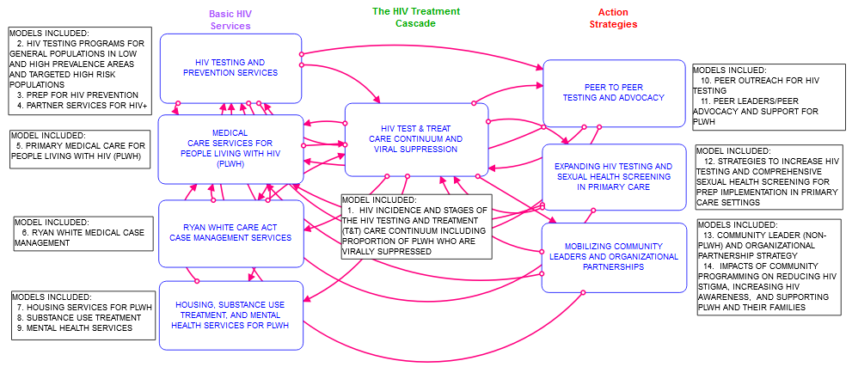
Full Research Model for Validation with Stakeholders
Stella© Model Landing Page
System Dynamics Modeling of the HIV Test & Treat (T&T) Care Continuum
(14 SD Structures within 8 Modules)
Weeks MR, Lounsbury DW, et al., Simulating system dynamics of the HIV care continuum to achieve treatment as prevention. PLoS One 2020; 15(3): PMID: 32191771.

Slide 4
System Dynamics - SD GMB
Group Modeling Building (GMB) engages key stakeholders in all phases of modeling (Andersen et al. 1997; Luna-Reyes et al. 2006; Rouwette et al. 2002; Vennix 1996) (Scriptapedia 2011)
It supports collaborative co-investigation and co-learning about systems-level problems
It uses cycles of reflection with repeated and continuous model refinement to test the model structure and simulated model behavior

Slide 5
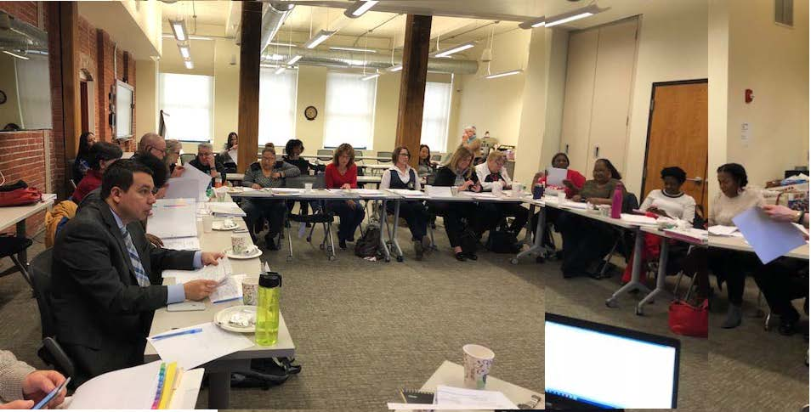
Greater Hartford HIV System Dynamics Modeling Task Force
February 14, 2018 GMB Session

Slide 6
Greater Hartford HIV System Dynamics Modeling
Task Force (N=31 with research team)*
Stakeholder Group: | N
People living with HIV [PLWH] (male, female, Black, Hispanic, gay, heterosexual, substance use history, young, older adult) | 5
MDs, APRN | 3
RN, Clinical Social Worker | 2
Case Managers (current and former, medical, non-medical) | 4
Program Coordinators/Directors (HIV Prevention; Substance Use Treatment; Housing for PLWH) | 4
Executive Directors of community and AIDS service organizations | 3
Policy/Peer Advocates/Activists | 7
State and City Health Department Unit or Program Directors | 3
Gilead Sciences Community Liaison | 1
Research Team | 6
* Some members have more than one role

Slide 7
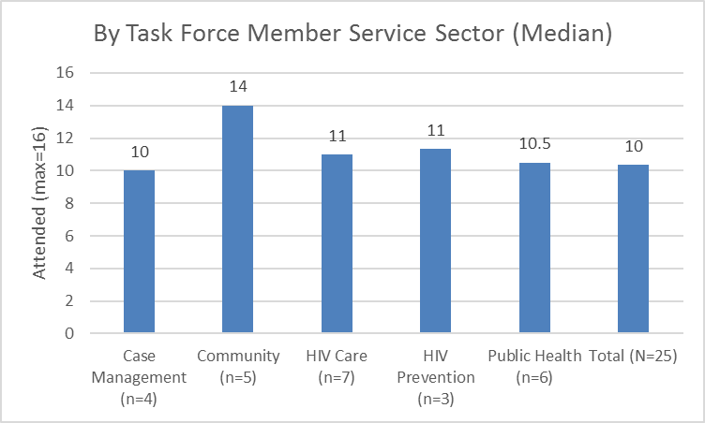
Group Model Building Sessions (2-year intervention period, N=16 sessions)
Average proportion of sessions attended by Task Force Members = 65% (55.6%, 74.4%, CI₉₅)

Slide 8
Implementing Group Model Building (GMB)
with the SD Modeling Task Force: Timeline
SD Task Force Modeling Session 2: Causal Loop Diagramming: Mapping the Variables
SD Task Force Modeling Sessions 3-7: Small Model Specification of Basic Services and Action Strategies
SD Task Force Modeling Sessions 11-16: Full Model Review: All Modules/Models Structural and Behavioral Validation
SD Task Force Modeling Sessions 8-10: Small Model Validation: Basic Services and Action Strategies
SD Task Force Modeling Session 1: Variable Identification/ Definition
SD Modeling Task Force Intro
to SD Modeling
Winter
2016-17
Spring
2017
Summer
2017
Fall
2017
Winter- Spring
2018
Spring-Summer
2018
Dec.
2016
Jan.
2017
Feb.
2017
March- June
2017
Sept-
Dec.
2017
Jan.- June
2018
Research Team Develops ‘Scripts’ for Modeling Sessions
Research Team Identifies ‘Stories’ (Small Models) in the CLDs
Research Team Develops Structures and Calibrates Small Models
Research Team
Revises Model
Structures and Calibrations
Research Team Prepares Model and Interface Tools for “Getting To Zero” Task Force Applications
Research Team Develops Model Documentation and User Interface Tools

Slide 9
Method: Post-GMB Process Evaluation
Assessment of Quality of Engagement among Taskforce Members:
Retrospective in-depth qualitative key informant interviews from the selected Task Force Members (N=8 members interviewed)
Transcribed and coded by two coders, adjudicated by DL
Dedoose Qualitative Data Analysis Software
Themes about the quality of engagement and the benefits/drawbacks of participating were identified

Slide 10
Results
Major Themes (T1-T5) Describing GMB Participants’ Co-design Experience:
T1: Insights about implementing "out of the box" solutions
T2: A deeper understanding of HIV treatment dynamics for prevention at the community level
T3: Development of professional "soft skills" for systems change (e.g., advocacy, leadership, communication, creative thinking)
T4: Clarity on leveraging limited community resources to improve care quality
T5: Valuing Community Expertise

Slide 11
T1: Insights about implementing "out of the box" solutions
Complex solutions offer broad insights
“[With the model] I could imagine a different approach and how I could work to make it a better system, and what areas I could look into when it comes to financials, and stuff like that, to expand services.”
Quantification of important variables
“[We] utilized all this knowledge of the HIV continuum of care to develop this system dynamics model where you can quantify how important each variable was, and to get, at the end [of a simulation run], a way to interpret outcomes about how much of a resource is needed in a certain area.”

Slide 12
T2: A deeper understanding of HIV treatment dynamics for prevention at the community level
Systems thinking for HIV solutions
“And unless we analyze what is happening, in this type of comprehensive view, we may never solve this problem, because everyone will continue to do whatever they have been doing.”
Fostering a deeper understanding of health system dynamics
“[The model] supposes what I'm doing-- it's not only teaching me how to engage in what we've been doing, but also it's teaching me how to use [surveillance and clinical] databases, and all that stuff.”

Slide 13
T3: Development of professional "soft skills" for systems change (e.g., advocacy, leadership, communication, creative thinking)
“I am still amazed when I look at the tool, how [it] details the entire process from start to finish. . . . When you are a client going through the process, I don't think you see all of these components. And being a worker in the field, again, you get disconnected from the entire puzzle. Seeing it all put together was astounding to me. It puts [the system] into better perspective, exactly [showing] what the clients are having to go through just to get to the end of hopefully, um, undetectable viral load.”

Slide 14
T4: Clarity on leveraging limited community resources to improve care quality
Simplifying complex models for action
“The project is great because you're able to address all the possible factors that might be influencing HIV incidence…. By concentrating analysis on the most impactful determinants, the model… yields clearer, more actionable results."

Slide 15
T5: Valuing Community Expertise
Being Heard
"So, that right there, that was like a really big piece, where you [the researchers said], 'Okay, we're gonna listen to these people with these experiences,' who are saying, you know, 'Use us, let us help bring this on, to get to zero HIV.' And you listened to that, and you came, and you put it into the model. So that was something even more substantial.“
Communication
“But I think that the integration of stakeholders and the recognition of each other was an unintended consequence that I think is good. I think in the end it'll help.”

Slide 16
Suggestions for Improving the Codesign Process in SD GMB
Prioritize Community Understanding
Simplify Complexity
Foster Skill Development
Show Mutual Benefit
Implementing Changes

Slide 17
Limitations of the Post-GMB Process Evaluation
Sampling Bias: 32% (8 out of 25 – 5 out of 8: community advocates)
Subjectivity and Researcher Bias: DL conducted all interviews
Limited Generalizability: single case study

Slide 18
Conclusion & Impact
Taskforce members’ expertise was essential to building and validating a useful SD model
The biggest challenge in the codesign process was to address the complexities of both the method and the model
Taskforce members reported a deeper understanding of the significance of their roles and responsibilities in working together to improve HIV outcomes

Slide 19

Thank You!

Slide 20
Thanks to the HIV CVL SD Modeling Task Force & Facilitation Team
Merry Bajana, St. Francis Hospital and Medical Center/Gengras Clinic*
Christina Cipriani, Hartford Dispensary*
Angelique Croasdale-Mills, Ryan White Greater Hartford*
Ricardo Cruz, HRA of New Britain
Robin Deutsch, MD, Brownstone Clinic*
Linda Estabrook, Hartford Gay & Lesbian Health Collective*
Alice Ferguson, Community member
Nilda Fernandez, CCMC*
Seja Jackson, APRN Burgdorf Clinic*
Heidi Jenkins, CT Dept. of Public Health*
Jen Krebsbach, Gilead Sciences
Shawn Lang, AIDS CT*
Clifford Lumpkin, Community member
John Merz, AIDS CT*
Mauricio Montezuma, MD, Community Health Services*
Fernando Morales, Latino Community Services (LCS)*
Tung Nguyen, Hartford DHHS*
Bill Petrosky, Hartford Gay & Lesbian Health Collective
Janette Rodriguez, Community member
Romario Roper, Community member
Ashley Rosario, Community member
Carol Steinke, Hartford DHHS, STI clinic
LaToya Tyson, AIDS CT
Yolanda Velez, LCS and Burgdorf Clinic
Danielle Warren-Diaz, CCMC
SD Modeling Facilitation Team:
Maryann Abbott, ICR*
Marcie Berman, ICR*
Natalie Garcia, ICR*
Rosie Gonzalez, ICR*
Danielle Green, ICR*
Jianghong Li, ICR*
David Lounsbury, Albert Einstein*
Heather Mosher, ICR*
Lucy Rohena, ICR*
Margaret (Peg) Weeks, ICR*
* Steering Committee members

